Slide 1



URoute We route your route.
Team: Ctrl Alt Elite
Presented by
Harini
Maalavya Mani
Sanjay Kumar
Shivani
Sri ram Reddy
Sushma

Slide 2
Problem Statement
Any customer will want to save his time while shopping and doesn’t like to end up in the same place more than once.
What if the customer is provided with a shortest route according to his products wish list?

Slide 3
Introduction\Proposed solution
Technologies Used
JAVA
Html
CSS
SVG
Java Script
JSON
Firebase
xml
URoute enables the customer with the option to select the products from the list of items present in the store catalogue.
App takes this wish list calculates best route and displays on the customers screen.
Our solution is Shortest and best route to customer for easy shopping.
Tools Used
Android Studio
Database
Firebase

Slide 4
Benefits
“URoute” saves customer’s precious time.
Hassle free movement of customers in store.
User friendly application, which provides easily interpretable route visualization

Slide 5
Future Enhancements
Capturing the floor map of the store and availability of products with the help of CC Cameras installed.
Integrating URoute app with inventory of the store , so that product status can be updated in the application
We can extend our idea of shortest route generation to “finding the best route for shopping in different stores that are subscribed to our company”

Slide 6
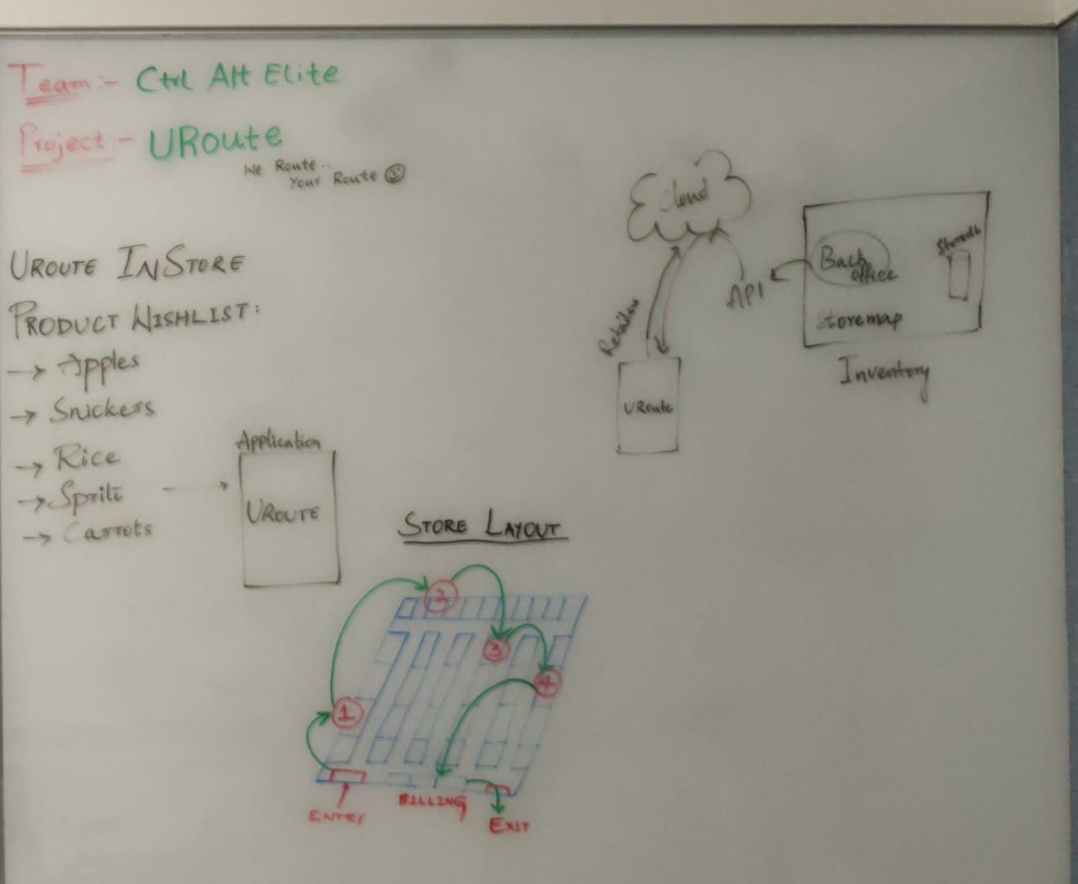

Slide 7
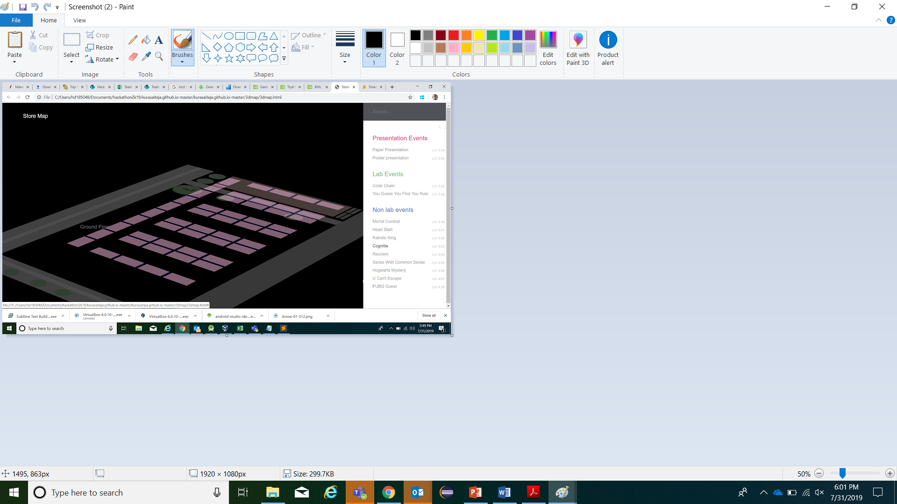
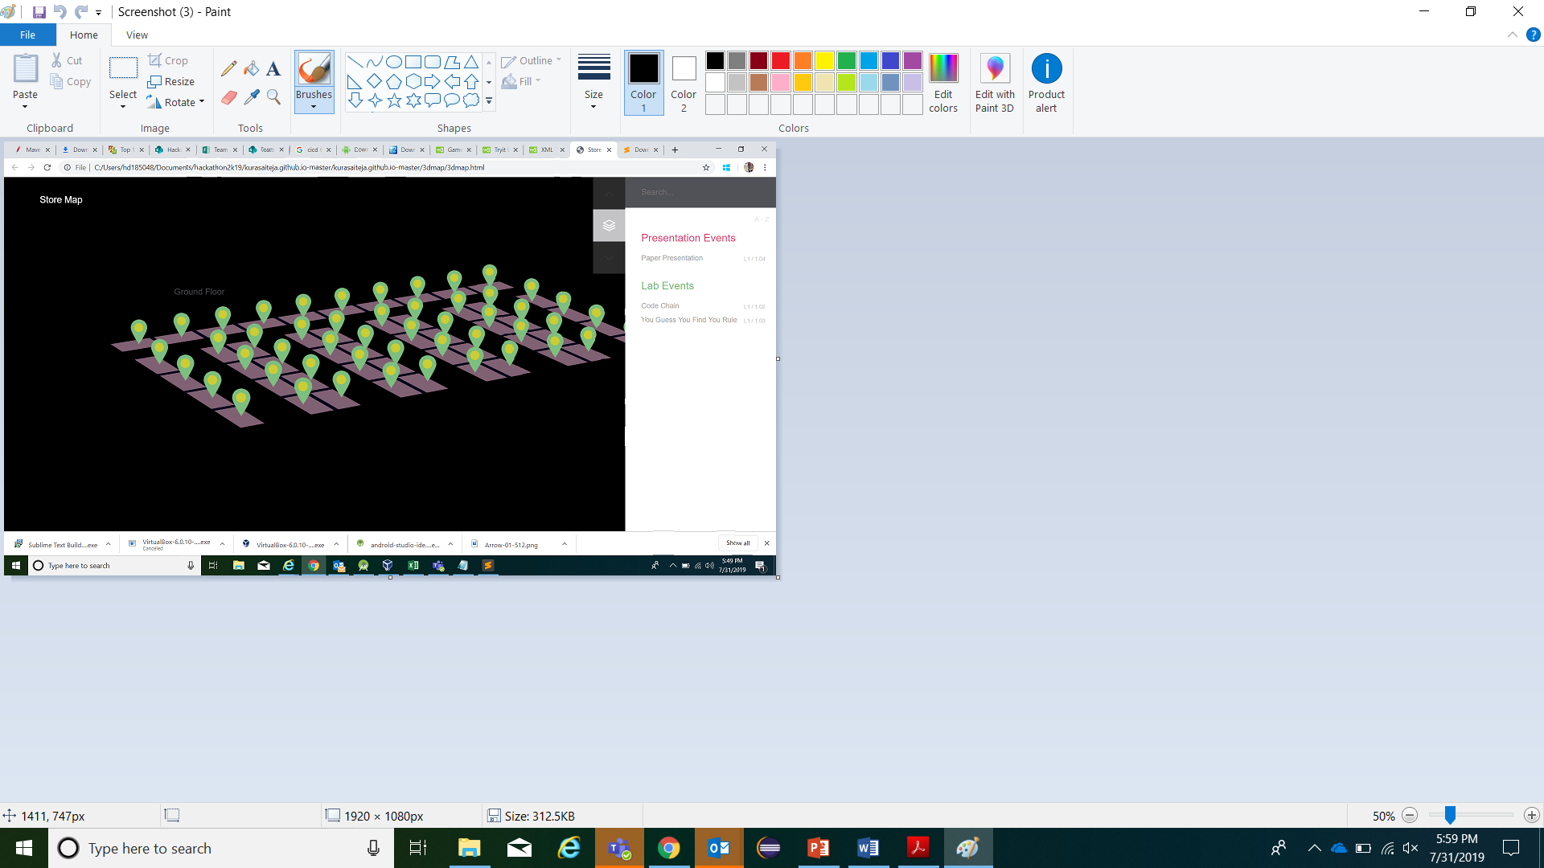
Floor Maps

Slide 8
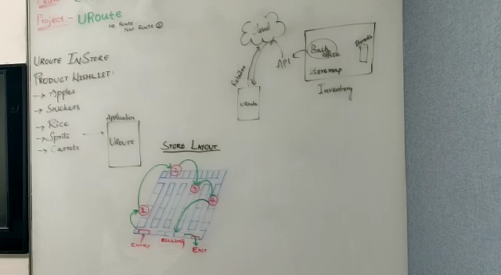
Demo Video

Slide 9
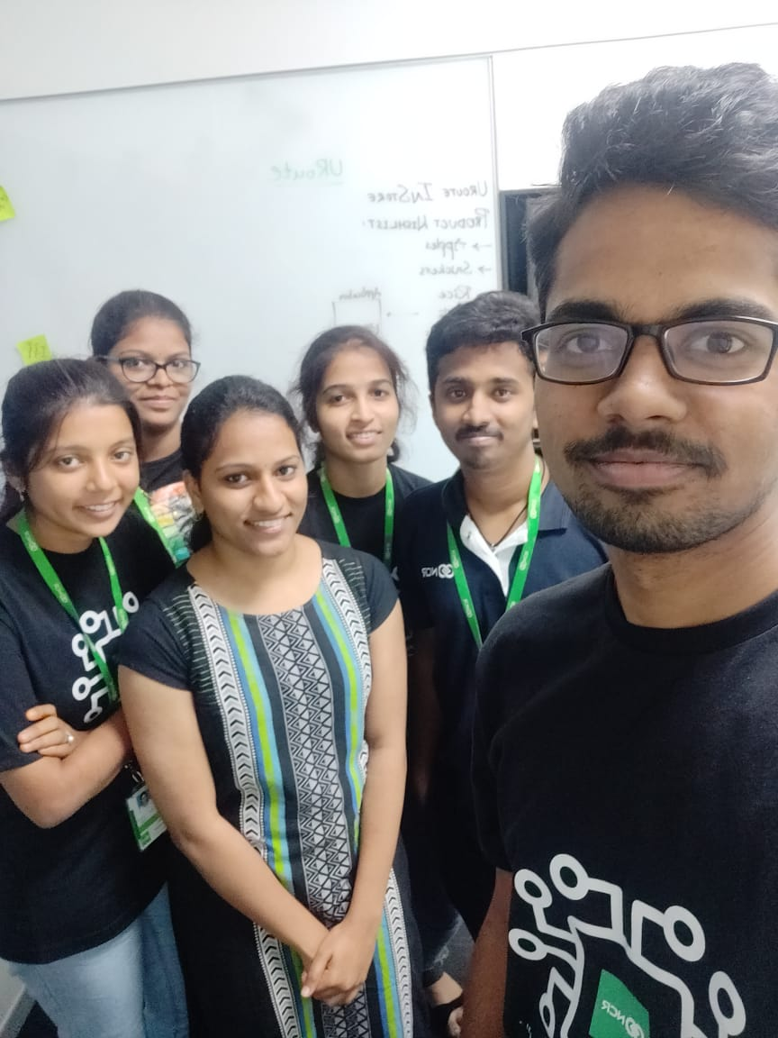
Team Selfie
Thank you

Slide 10
THANK YOU

